Slide 1

Instructions for Maths Maze navigator
Use the arrow keys to move the player
Traverse through the maze
A limited amount of moves will be given
When the move count reaches 0 then a maths question will pop up
Collect the key to win the game
A score will be calculated at the end
If you lose all lives then you lose the game
An end screen will show depending on if you win or lose
Enjoy!

Slide 2

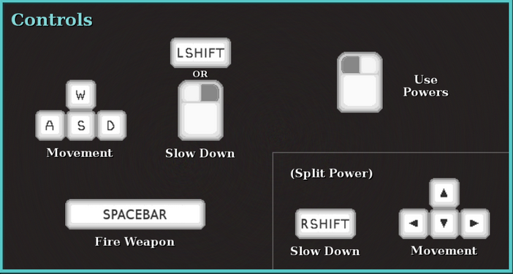
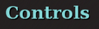
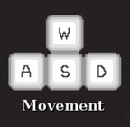
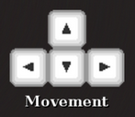

Toggle Fullscreen

Slide 3

You Win!!!

Slide 4
You Lose!!!

Slide 5



SAVE GAME
HINT
LOAD GAME

Slide 6
Game saving…
Click anywhere to go back to game!

Slide 7
Game loading…
Click anywhere to go back to game!

Slide 8
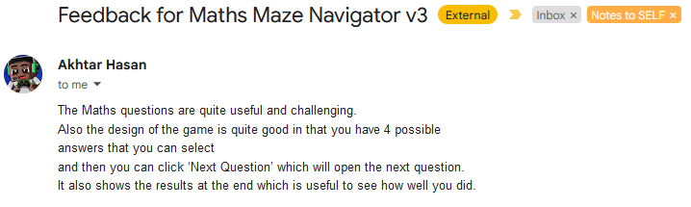


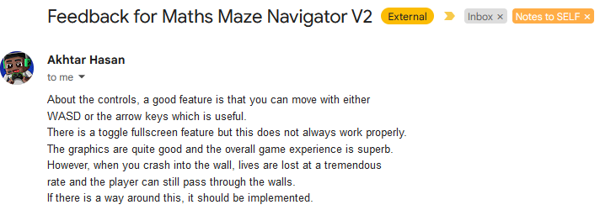


Slide 9
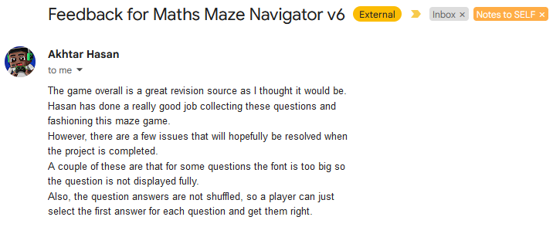
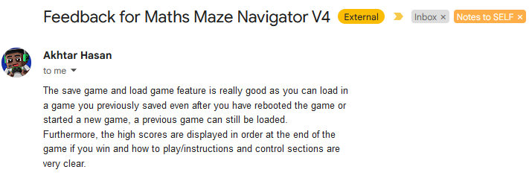

Slide 10
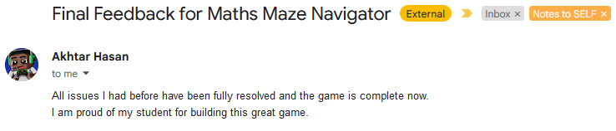
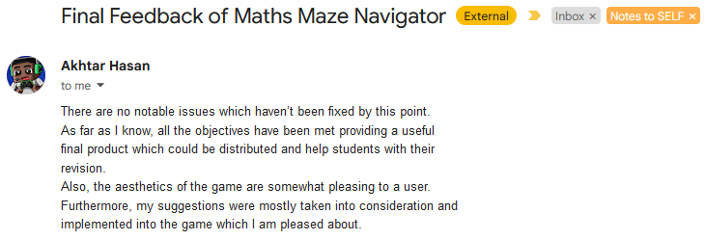

Slide 11
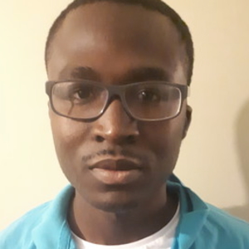
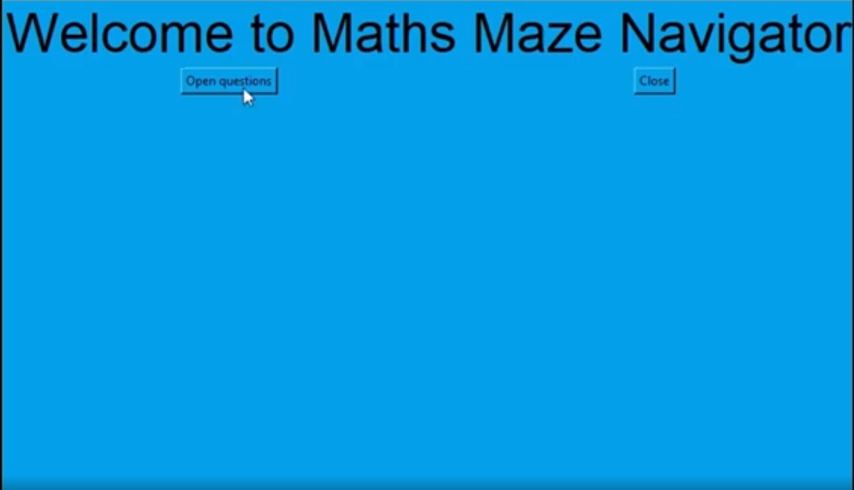
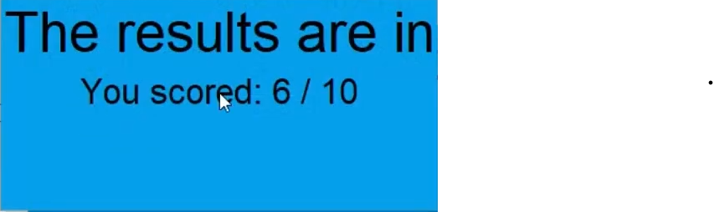
Mr Ninson End user testing - MMN V3

Slide 12
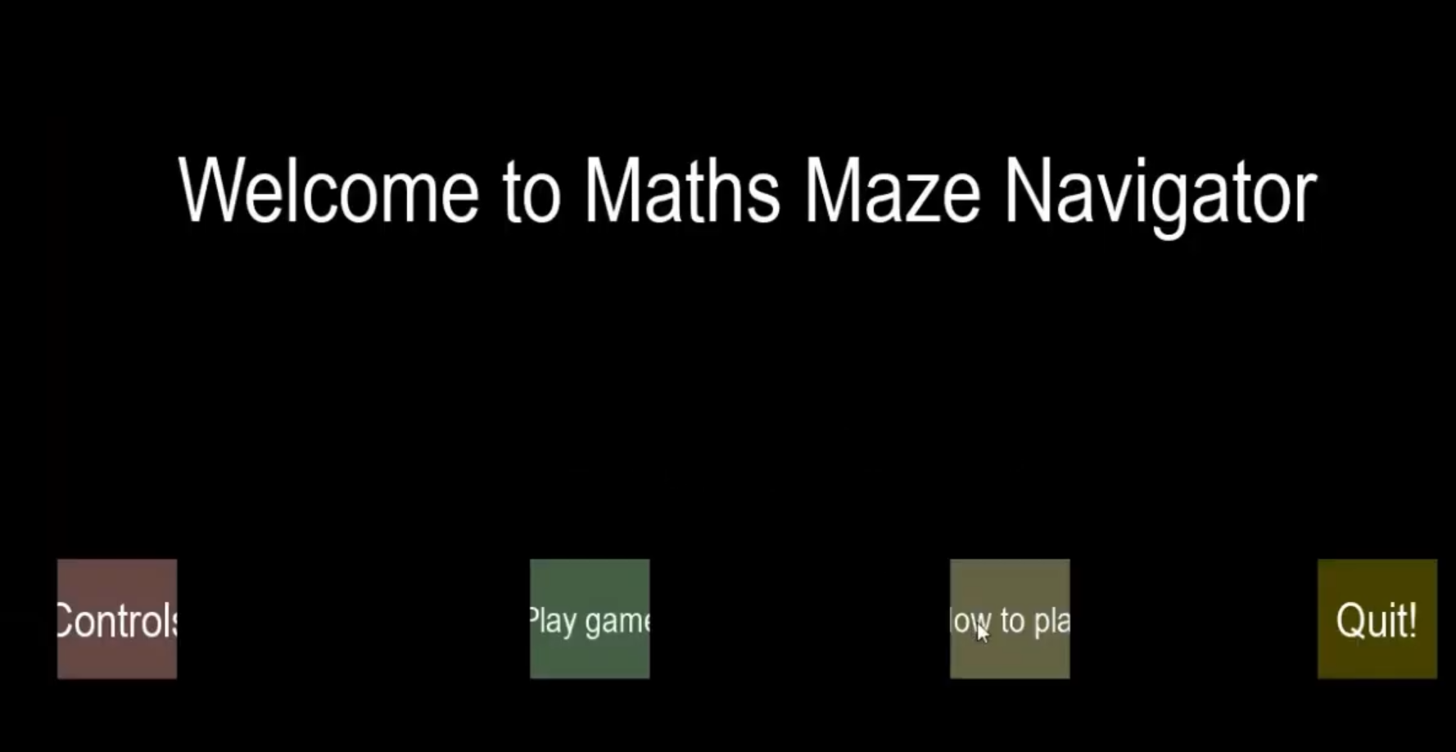
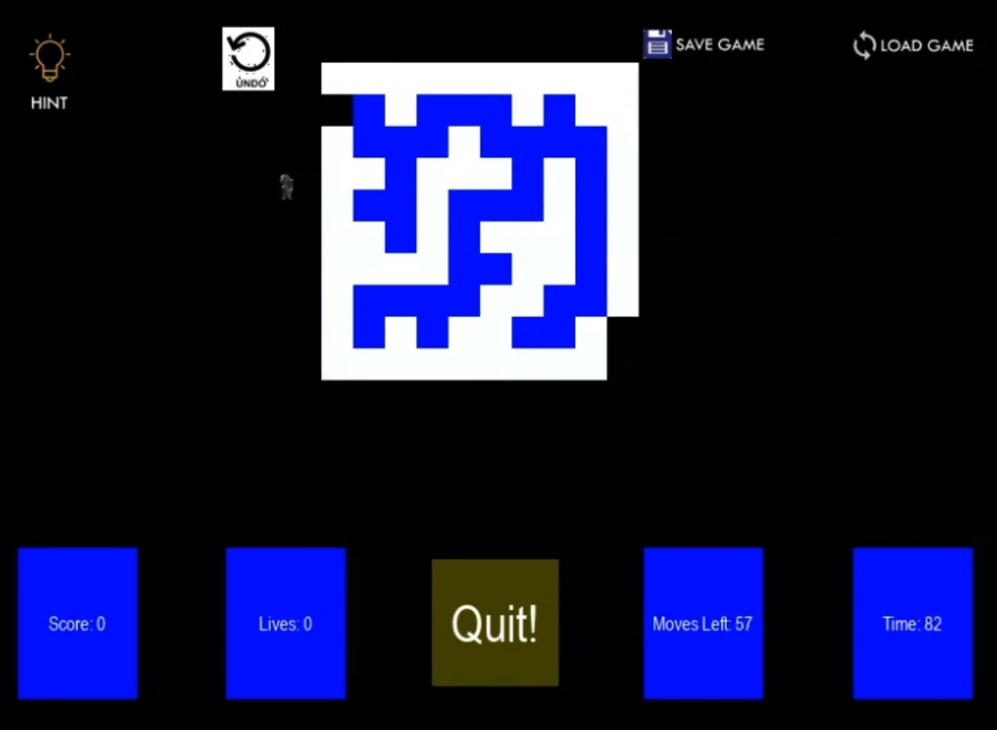
Mr Ninson End user testing - MMN V6

